Slide 1

Dubai Estates Prices
Hasan Soufan
10/1/2023

Slide 2
Outline
Executive Summary
Introduction
Methodology
Results
Conclusion
Appendix

Slide 3
Executive Summary
Dubai’s Estates Prices Prediction.
We want to reduce the time and the effort of searching about the Meter Price of the estates in Dubai by predict the Meter Price and figuring out what features effect it.
Starting by collecting the data from Dubai Government Land Department, then doing some wrangling to find patterns in the data.
Using exploratory data analysis (EDA) find information like distribution between the standards and the Meter Price.
Using Statistical Experiments and significance testing find standards that have effect on the Meter Price.
Performing a predictive analysis and building models to predict the Meter Price depending on the previous standards and chose the best models based on some metrics like R-Square.
The results that we can figure out which standards effect the Meter Price and predict its value with 67% of certainty.

Slide 4
Introduction
Dubai Estates are being bought and sold many times and when someone need to buy/sell an estate, it need another one to approximate the meter price, instead of searching for its prices and features that effect that price, this project is to figure out the way to make this process easy and fast based on studding Dubai Real Estates data for 2022.
Depending on the previous we will study Dubai Real Estates Data to figure out the following:
What are the features that effect the meter price of the estates.
Build a prediction model trying to predict the meter price based on the different situation of the previous standards.

Slide 5

Methodology
Section 1

Slide 6
Methodology
Executive Summary
Data Collection, data was collected using Dubai Government Land Department Website.
Data Wrangling, solved any problem in the data like extreme values .. , found patterns and object types of each feature like rooms and Areas.
Exploratory Data Analysis (EDA), using visualization to figure out which features could effect or related to the Meter Price like Near Landmark, Near Metro .. .
Statistical Experiments and Significance Testing, using some testing methods found features that effect the Meter Price.
Predictive Analysis, built regression models like K Nearest Neighbors and XGBoost, evaluated by R Square, MAE* and MSE*
*MAE : Mean Absolute Error
*MSE: Mean Squared Error

Slide 7
Data Collection
the data was collected from Dubai Government Land Department Website Here, as a csv file, then extracted, here some of it
Transaction Number | Transaction Date | Property ID | Transaction Type | Transaction sub type | Registration type | Is Free Hold? | Usage | Area | Property Type | Property Sub Type | Property Size (sq.m) | Room(s) | Parking | Nearest Metro | Nearest Mall | Nearest Landmark | No. of Buyer | No. of Seller | Master Project | Project
102-1-2022 | 2022-01-03 07:30:34 | 1131371499 | Sales | Sell - Pre registration | Off-Plan | Free Hold | Residential | DUBAI HARBOUR | Unit | Flat | 119.25 | 2 B/R | 1 | NaN | NaN | NaN | 1 | 1 | NaN | Beach Mansion
102-10-2022 | 2022-01-03 07:32:56 | 100227279 | Sales | Sell - Pre registration | Off-Plan | Free Hold | Residential | Wadi Al Safa 7 | Unit | Flat | 33.44 | Studio | 1 | NaN | NaN | NaN | 1 | 1 | NaN | RUKAN
102-100-2022 | 2022-01-03 12:30:23 | 1147007457 | Sales | Sell - Pre registration | Off-Plan | Free Hold | Residential | ARJAN | Unit | Flat | 51.05 | 1 B/R | 1 | Sharaf Dg Metro Station | Mall of the Emirates | Motor City | 1 | 1 | NaN | SKYZ By Danube
102-1000-2022 | 2022-01-10 13:21:58 | 1133339823 | Sales | Sell - Pre registration | Off-Plan | Free Hold | Residential | BUSINESS BAY | Unit | Flat | 36.24 | Studio | 1 | Business Bay Metro Station | Dubai Mall | Downtown Dubai | 2 | 1 | NaN | Peninsula One
102-10000-2022 | 2022-04-13 11:21:32 | 1171598130 | Sales | Sell - Pre registration | Off-Plan | Free Hold | Residential | Jumeirah First | Unit | Flat | 118.34 | 2 B/R | 1 | NaN | NaN | NaN | 1 | 1 | NaN | Port De La Mer - Le Ciel

Slide 8
Data Wrangling
Dealing with Null values.
Figuring out features types and patterns, found that there are features with non balanced data like (Usage) and features with many unique values like (Parking).
created label column as Meter Price by dividing (Amount on Property Size sq.m).

Slide 9
Exploratory Data Analysis
Histogram plot: the distribution of the (Meter Price) feature showed that it skewed to the left.
Box Plots: show the distribution of the features and figuring out if there is any overlapping between the categories in each of the following features:
Transaction Type vs Meter Price.
Area vs Meter Price.
Rooms vs Meter Price.
Parking vs Meter Price.
Nearest Metro vs Meter Price.
Nearest Mall vs Meter Price.
Nearest Landmark vs Meter Price.

Slide 10
Statistical Experiment
ANOVA testing: this method was used because all of the features have categorical type data and the label is continuous:
features that we selected have an effect on the label (Meter Price) with P-value near to zero.

Slide 11
Predictive Analysis
Apply one hot encoding on the features, then because that all of the features are binary we did Corresponding Analysis (CA) as a feature reduction method to reduce the dimensions from 43 to 28.
We split the dataset into train and test data to test the models if they accurate on samples from out of the range.
Using Grid search and cross validation for model selection, and hyper parameter tuning.
Train regression models (K Nearest Neighbors – XGBoost – Random Forest Regressor – Neural Network)
Using metrics like R-Square, MAE, MSE, and Sum of Residuals to evaluate the models and selecting the best model.

Slide 12
Results
Exploratory Data Analysis:
There are too many outliers and the label skewed to the left so we encode it using log.
There is overlap between (Rooms) categories.
There is overlap between (Parking) categories.
There is a little overlap between (Nearest Metro) categories.
There is a little overlap between (Nearest Mall) categories.
Statistical Experiment:
Transaction Type effect the label.
Area effect the label.
Rooms effect the label.
Parking effect the label.
Nearest Metro effect the label.
Nearest Mall effect the label.
Nearest Landmark effect the label.
Predictive Analysis:
More than one model can predict the Meter Price with 67% of certainty.

Slide 13
EDA Insights
Section 2

Slide 14
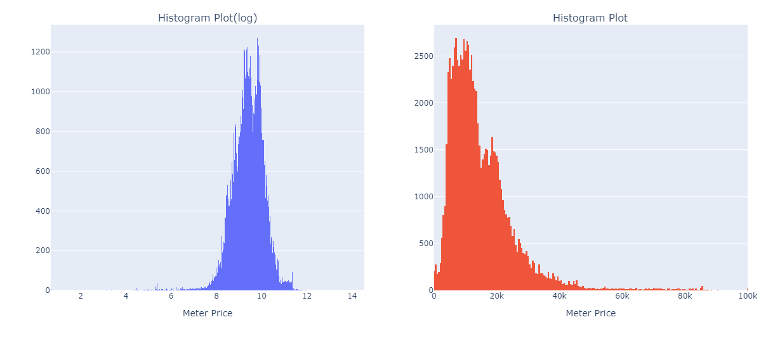
Meter Price Distribution
We found that (Meter Price) skewed to the left, so we take the (log) of it as in the blue plot.

Slide 15
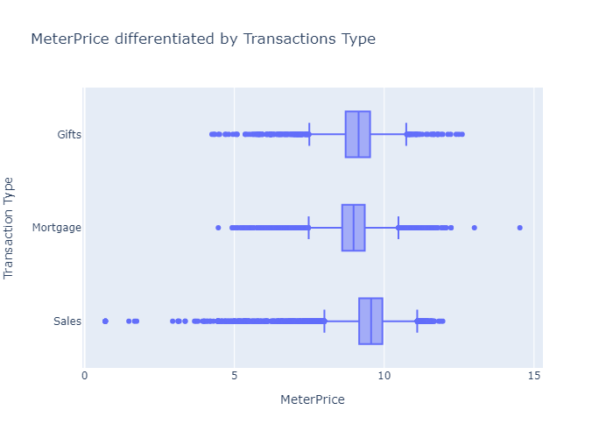
Meter Price differentiated by Transactions Type
We found that (Transaction Type) categories have difference in the median, also in the spread specifically in the outliers.

Slide 16
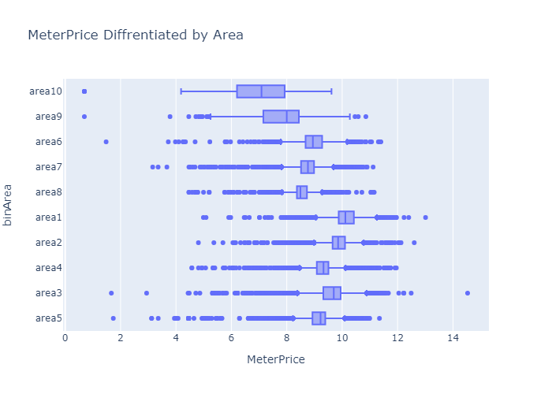
Meter Price differentiated by Area
After we binned the feature (Area) due to its many value, We found that its categories have difference in the median, also in the spread

Slide 17
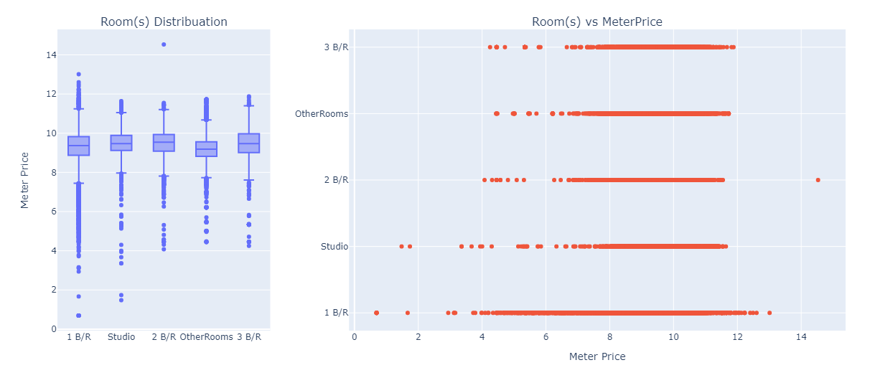
Meter Price differentiated by Rooms
We found that (Rooms) categories medians are closed and there is overlap.

Slide 18
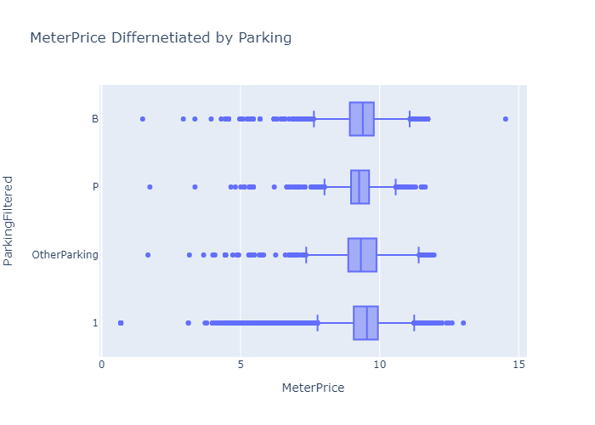
Meter Price differentiated by Parking
After we filtered the feature (Parking) due to its many values We found that its categories medians are closed and there is overlap.

Slide 19
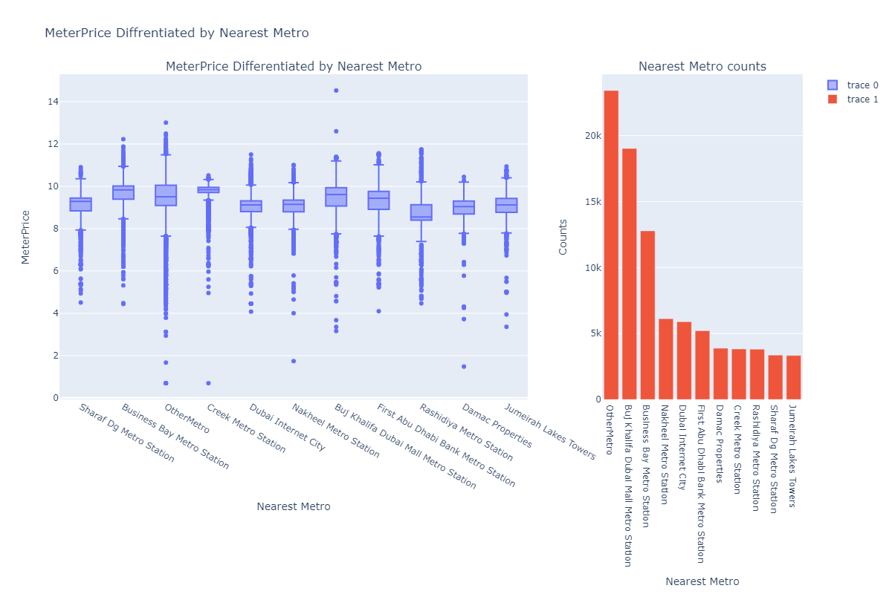
Meter Price differentiated by Nearest Metro
We found that (Nearest Metro) categories have overlap but have difference in the medians and counts.

Slide 20
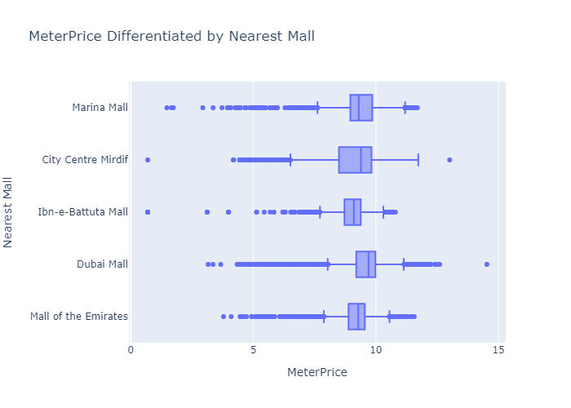
Meter Price differentiated by Nearest Mall
We found that (Nearest Mall) categories have a little overlap but have difference in the median and the spread.

Slide 21
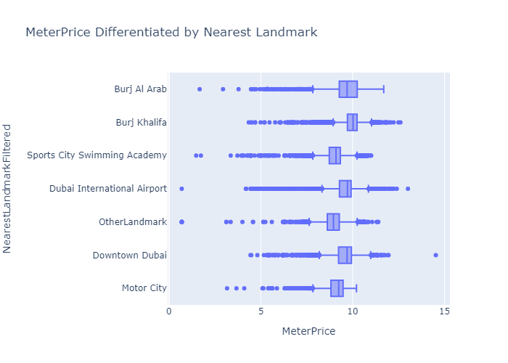
Meter Price differentiated by Nearest Landmark
We found that (Nearest Landmark) categories have difference in the median and the spread.

Slide 22
Meter Price differentiated by Nearest Landmark
We found that (Nearest Landmark) categories have difference in the median and the spread.

Slide 23
Real estates Transactions
Transaction Type | Area | Room(s) | Parking | Nearest Metro | Nearest Mall | Nearest Landmark | MeterPrice
Sales | ARJAN | 1 B/R | 1 | Sharaf Dg Metro Station | Mall of the Emirates | Motor City | 12732.615083
Sales | BUSINESS BAY | Studio | 1 | Business Bay Metro Station | Dubai Mall | Downtown Dubai | 20719.536424
Sales | DOWN TOWN JABAL ALI | Studio | 1 | UAE Exchange Metro Station | Ibn-e-Battuta Mall | Expo 2020 Site | 12825.112108
Sales | DUBAI CREEK HARBOUR | 2 B/R | 1 | Creek Metro Station | City Centre Mirdif | Dubai International Airport | 16312.785263
Sales | JUMEIRAH VILLAGE CIRCLE | 1 B/R | 1 | Dubai Internet City | Mall of the Emirates | Sports City Swimming Academy | 9317.785349

Slide 24
Number Transaction Type
Transaction Type | Counts
Sales | 67723
Mortgage | 18812
Gifts | 4124

Slide 25
Top 5 Areas based on the number of Transactions
Area | Counts
BUSINESS BAY | 12674
JUMEIRAH VILLAGE CIRCLE | 7082
DUBAI MARINA | 6193
BURJ KHALIFA | 6156
PALM JUMEIRAH | 4257

Slide 26
Top 5 Rooms based on the number of Transactions
Room(s) | Counts
1 B/R | 38032
2 B/R | 21940
Studio | 14639
3 B/R | 9207
Office | 3141

Slide 27
Top 5 Nearest Metro based on the number of Transactions
Nearest Metro | Counts
Buj Khalifa Dubai Mall Metro Station | 19026
Business Bay Metro Station | 12781
Nakheel Metro Station | 6125
Dubai Internet City | 5889
First Abu Dhabi Bank Metro Station | 5212

Slide 28
Number of Nearest Malls
Nearest Mall | Counts
Dubai Mall | 36331
Marina Mall | 27432
Mall of the Emirates | 13423
City Centre Mirdif | 7884
Ibn-e-Battuta Mall | 5589

Slide 29
Number of Nearest Landmarks
Nearest Landmark | Counts
Downtown Dubai | 23966
Sports City Swimming Academy | 19520
Burj Al Arab | 16447
Motor City | 8419
Burj Khalifa | 7428
Dubai International Airport | 6536
IMG World Adventures | 3725
Expo 2020 Site | 3437
Dubai Cycling Course | 582
Global Village | 290
Al Makhtoum International Airport | 225
Dubai Parks and Resorts | 82
Jabel Ali | 2

Slide 30

Predictive Analysis (Regression)
Section 3

Slide 31
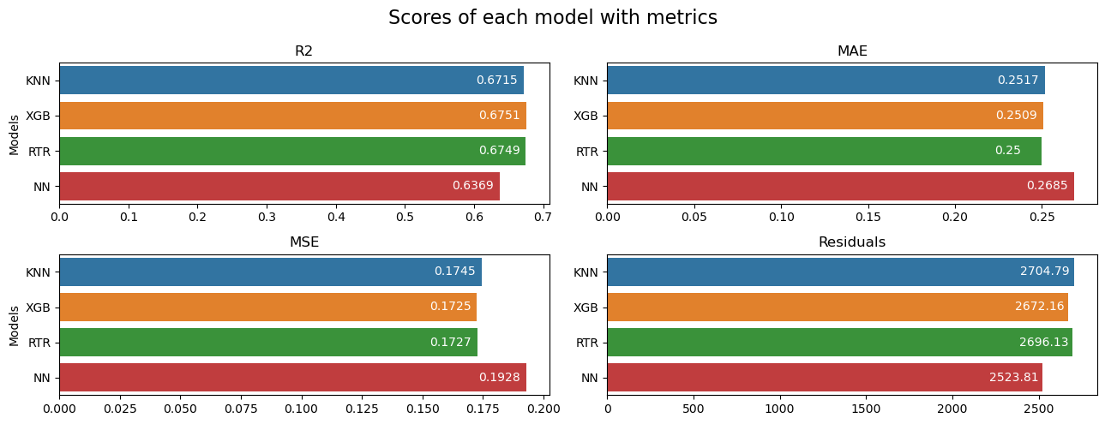
Regression R-Square
The R-Square of (KNN, XGB and RTR) are very close, but neural network is less than the others.

Slide 32
Regression Mean Absolute Error
The MAE of (KNN, XGB and RTR) are very close, but neural network is higher than the others.

Slide 33
Regression Mean Squared Error
The MSE of (KNN, XGB and RTR) are very close, but neural network is higher than the others.

Slide 34
Regression Residuals
The MSE of (KNN, XGB and RTR) are very close, but neural network is less than the others.

Slide 35
Conclusions
Studied the real estates data from Dubai Government Land Department to figure out what features that have an effect on the Meter Price of the estates in Dubai and built a prediction model to predict the Meter Price.
Found that there is a relation between (Transaction Type, Area, Rooms, Parking, Nearest Metro, Nearest Mall and Nearest Landmark) and the (Meter Price).
Performed a predictive analysis and built a regression models to predict the Meter Price based on the previous standards, evaluated by R-Square, MAE, MSE and Residuals metrics, afford in the best situation 67% of certainty, using the XGBoost model because it is fast more than the others.
The results are we can figure out what the standards that effect the Meter Price in Dubai and predict it with 67% of certainty.

Slide 36
Appendix
x

Slide 37

Thank You!

